Slide 1
Service Versioning Proposal
Proposal on how to version Middleware Services
v18/05/2020
Notes:
Motivation
Long time to define, validate and deliver service versions
Difficulties to identify the impact of a major change
High cost of develop, improve and fix services
Lack of reusability of services
SI Squad middleware services not seen as a toolbox where a tool is there to be used

Slide 2
Introduction
Goals, principles, premises, assumptions and concepts.
Notes:
Next slides are the base to take the decisions on how to version middleware services.
Following these principles and values brings unforeseen advantages.

Slide 3
Goals
Create an integration services versioning process that are simple to use, easily evolvable and reliable
Allow loosely coupled evolution of services and clients
Reduce time and cost to prod
Turn our clients’ lives easier
Notes:
Allow loosely coupled evolution of services and clients
Service operations can evolve at any pace. Don’t need to wait the clients to evolve together.
Clients can evolve at their pace.
Reduce time to prod
Services are created, maintained, fixed very quick.
By creating loose coupled versions, they can be deployed at any time, no wait for any other system or team to be ready.
Turn our clients’ lives easier
Make our clients happy and willing to consume middleware services.
Providing less complex services and ways of consuming them.

Slide 4
Principles
Be technology agnostic
Follow the community best practices
Separation of Concerns
KISS – Keep It Stupid Simple
Don’t reinvent the wheel
Satisfy your customers (services’ consumers)
Focus on the business solution
Notes:
Be technology agnostic – Use the technology that better suites your needs, is cheaper or the team is most comfortable with.
Follow the community best practices – The problem we are going through now has already happened to someone else. The best practices are heavily tested solutions for these problems.
Separation of Concerns – Focus on your job and on what you have authority to act.
KISS – Keep It Stupid Simple – Don’t complicate things. Try to find the easiest possible solution. Systems work better if they are kept simple.
Don’t reinvent the wheel – If some solution is out there, evaluate it and use it if possible. It is cheaper to use, faster to deploy, more reliable and easier to maintain.
Satisfy your customer – As any sales company, we must treat our customers well. In the integration layer, our customers are the services’ consumers. The channels and other services.
Focus on the business solution – Middleware services must implement the integration layer.
Agile Manifesto:
Our highest priority is to satisfy the customer through early and continuous delivery of valuable software.
Welcome changing requirements, even late in development. Agile processes harness change for the customer's competitive advantage.
Deliver working software frequently, from a couple of weeks to a couple of months, with a preference to the shorter timescale.
Business people and developers must work together daily throughout the project.
Build projects around motivated individuals. Give them the environment and support they need, and trust them to get the job done.
The most efficient and effective method of conveying information to and within a development team is face-to-face conversation.
Working software is the primary measure of progress.
Agile processes promote sustainable development. The sponsors, developers, and users should be able to maintain a constant pace indefinitely.
Continuous attention to technical excellence and good design enhances agility.
Simplicity--the art of maximizing the amount of work not done--is essential.
The best architectures, requirements, and designs emerge from self-organizing teams.
At regular intervals, the team reflects on how to become more effective, then tunes and adjusts its behaviour accordingly.
All teams will henceforth expose their data and functionality through service interfaces.
Teams must communicate with each other through these interfaces.
There will be no other form of inter-process communication allowed: no direct linking, no direct reads of another team’s data store, no shared-memory model, no back-doors whatsoever. The only communication allowed is via service interface calls over the network.
It doesn’t matter what technology they use.
All service interfaces, without exception, must be designed from the ground up to be externalizable. That is to say, the team must plan and design to be able to expose the interface to developers in the outside world. No exceptions.

Slide 5
API Mandate at Amazon
All teams will expose their data and functionality through service interfaces
Teams must communicate with each other through these interfaces
There will be no other form of inter-process communication allowed
No direct linking, no direct reads of another team’s data store, no shared-memory model, no back-doors whatsoever
The only communication allowed is via service interface calls over the network
The technology used doesn’t matter
All service interfaces must be designed from the ground up to be externalizable
Must plan and design to be able to expose the interface to developers in the outside world
Notes:
Additional mandate:
Anyone who doesn’t do this will be fired. Thank you; have a nice day!
The principles:
All teams will henceforth expose their data and functionality through service interfaces.
Teams must communicate with each other through these interfaces.
There will be no other form of inter-process communication allowed: no direct linking, no direct reads of another team’s data store, no shared-memory model, no back-doors whatsoever. The only communication allowed is via service interface calls over the network.
It doesn’t matter what technology they use.
All service interfaces, without exception, must be designed from the ground up to be externalizable. That is to say, the team must plan and design to be able to expose the interface to developers in the outside world. No exceptions.
Principle of the existing versioning policy 1.0
Only major versions matter for the client
Each minor version and patch is compatible to all other minors versions and patches for the same major version.
Minor versions are transparent for the consumer
Minor versions and patches are internal concern of SI Squad and should not be exposed to the clients.
Be liberal in what you accept, be conservative in what you send
Robustness Principle, also known as Postel's law.
All data and functionality are exposed through service interfaces
All teams will henceforth expose their data and functionality through service interfaces.
All communication must be through service interfaces
Teams must communicate with each other through these interfaces.
The used technology doesn’t matter
It doesn’t matter what technology they use.
All service interfaces, without exception, must be designed from the ground up to be externalizable
Teams must plan and design to be able to expose the interface to developers in the outside world. No exceptions.
The only form of inter-process communication is via service interface calls over the network
There will be no other form of inter-process communication allowed: no direct linking, no direct reads of another team’s data store, no shared-memory model, no back-doors whatsoever. The only communication allowed is via service interface calls over the network.

Slide 6
Premises
Only one running service
No version number in the URL
Rely on infrastructure tools
Clients only need to know major versions
Version to use is decided at design time
Services serve consumers
Consumers are clients and our services must serve them
Short deployment cycle
Faster time to prod, easy version fix and rollback
Adhere to community standards
Notes:
Only one running service – KISS, Focus on the business solution
No version number in the URL – KISS, Focus on the business solution, Don’t reinvent the wheel, Satisfy your customers, Follow community best practices, Allows hyperlinks
Rely on infrastructure tools – Technology agnostic, Follow community best practices, Separation of concerns
Clients only need to know major versions – KISS, Satisfy your customers
Services serve consumers – Satisfy your customers
Short deployment cycle – Follow community best practices, Don’t reinvent the wheel
Adhere to community standards (IETF, IEE, ISO) – Follow community best practices, Don’t reinvent the wheel, Be technology agnostic

Slide 7
Assumptions
Routing is infrastructure concern
Many out of the shelf solutions available
Clients accepts the contract
APIs, services and operations end of life date
Notes:
Routing is infrastructure concern – Separation of concerns principle
Clients accepts contract – Comply with the agreement

Slide 8
Concepts
API
Set of services
Contract
Automates an specific business needs
Consumed by software components
Collection of swagger files with related objects
Well defined vocabulary (glossary)

Slide 9
Concepts
Service
Implements business solution
Composed of interface and code
Interface describes how to call and get the response
Code is the solution implementation
HTTP Service
Client-server, stateless, layered, cacheable and with uniform interface software component
Service that relies on the HTTP application protocol and its specification
Composed of URIs and methods
REST Service
HTTP Service that controls resource status
Composed Service
Orchestrate one or more services
A verb for the service name often defines a composed service

Slide 10
Concepts
Resource
Object with associated data, relationships to other resources, and a set of operations that changes its state
A noun service name often defines a resource
Operation
Is a way to interact with a service
URI and method
HTTP methods defines the operation (GET, POST, PUT)
Contract
Terms to agree when using the services and operations of an API

Slide 11
Proposal

Slide 12
Service Versioning Proposal
Only one running service in production
One URL per service
Clients only know major versions
Clients inform the version they know when calling an operation
Version operation, not service
Version information in Content-Type: and Accept: header parameters
Swagger files treated as code

Slide 13
Only One Service Version in Prod
Only one code running

Slide 14
Only One Service Version in Prod
Need only one unique URL to access the service and its operations
Major version numbers are passed in the header parameters
Content-Type:
Accept:
Code deals with all available major versions
Avoid multiplication of unused services versions deployed in prod
Notes:
Next slides present:
The theory
How to work with Swagger file
Example of a source code

Slide 15
Intercepting Filter – Major Versions
/SI/SrvA
Client A
Client B
Content-Type: application/nbs.si.v1+json
Content-Type: application/nbs.si.v2+json
Accept: application/nbs.si.v1+json
Accept: application/nbs.si.v2+json
Interceptor
Intercepts the response and, redirect it to the correct version or transform the load from V2 to V1
Interface
v2020-05-01 (Method v1,v2)
Implementation
Method v2.0.0
Interceptor v1
Notes:
New clients can start consuming version 2 of this service by informing v2 in the header parameters.
Existing clients also, as soon as they update their code to the new interface, they must change the Content-Type and Accept header parameter variables to work.
Client B was developed to consume interface v2 of this service’s Method. So, it sends the version 2 Content-Type and Accept values.
This requests/responses of version 2 don’t need to be intercepted and go straight to the implementation.

Slide 16
Intercepting Filter – Major Versions
/SI/SrvA
Client A
Client B
Client C
Content-Type: application/nbs.si.v3+json
Content-Type: application/nbs.si.v1+json
Content-Type: application/nbs.si.v2+json
Content-Type: application/nbs.si.v2+json
Accept: application/nbs.si.v3+json
Content-Type: application/nbs.si.v3+json
Accept: application/nbs.si.v1+json
Accept: application/nbs.si.v2+json
Accept: application/nbs.si.v2+json
Accept: application/nbs.si.v3+json
Interface
v2020-05-02 (Method v1,v2v3)
Implementation
Method v3.0.0
Interceptor v1
Interceptor v2
Notes:
When version 3 is developed, new intercepting filter is created to make it possible to be backward compatible to the previous versions.
New clients can be deployed consuming v3. Note that various client versions can work simultaneous with only one major version in prod.
Old clients can evolve to consume the latest v3 version. (Or a previous v2 version if the development has started before v3 was available)

Slide 17
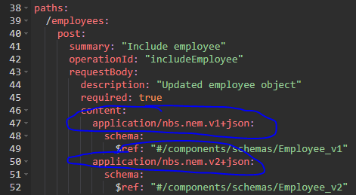
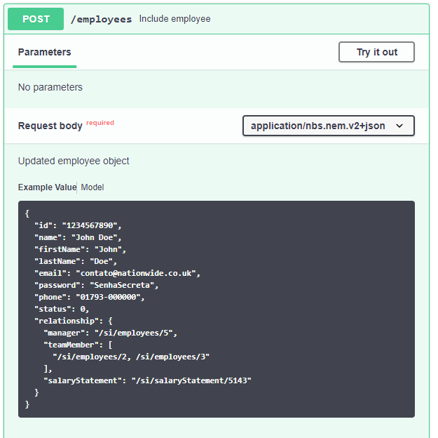
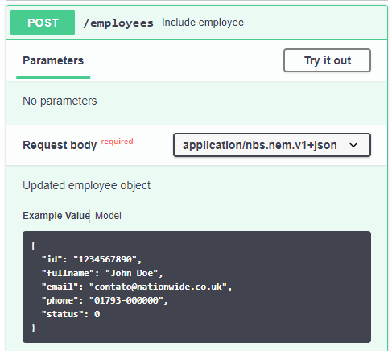
Content-Type HTTP Header – Versioning
OpenApi 3.0
Notes:
In the same swagger file, various versions can co-exist.
Also, by using the Swagger editor, one can see a load sample just choosing the drop-down menu.
See how easy it is to describe the string expected in the Content-Type header parameter that contains the version number.

Slide 18
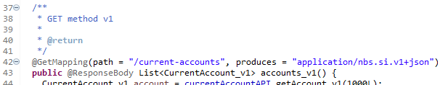
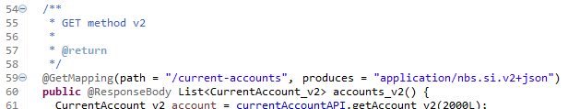
GET: Method accountsvX() – Source code POC
Notes:
Using Java with SpringBoot
GET Example
POJO code for version 1 of a (Java) method that returns a list of current accounts.
Annotations that inject the code for a REST GET endpoint, filtered by version v1.
Version 2 is another POJO code. Another (Java) method that can be in the same source code.
Simple annotation to indicate a GET method version 2.
In the annotation:
path: defines the resource path.
produces: describes what kind of content it produces.
The produces annotation field describes which Accept header parameter is accepted by this (Java) method. SpringBoot automatically maps the request to this (Java) method when the values matches.

Slide 19
Routing Mechanism
DNS
Network firmware

Slide 20
Routing Mechanism – Rely on DNS
No route extra mechanism needed in code
Rely on DNS and existing infrastructure
Proposed solution
Service has an unique URL
Only one running service for all versions
Version operations using HTTP header parameter
Notes:
Routing is an infrastructure concern.
Development and infrastructure “talk” during the deployment. Any versioning consideration must be agreed and implemented during this process.
No multiplication of URLs for each version and operation.
Simplification of deployment and going live.

Slide 21
Routing Mechanism – URL Proposal
URL: <HostName>/<ApiName>/<ServiceName>[/{ids}…][?<queries>]
HostName
A Nationwide externalizable URL
Ex: api.nationwide.co.uk
ApiName
A set of business automation services that should be covered by a contract
Can be related to an organization or team
Ex: si, ob, samm
ServiceName
The name of a service
Ex: accounts, involved-parties, involved-parties/1234
Composed of actions, resources, sub-resources, ids, queries etc.
Example: https://api.nationwide.co.uk/si/involved-parties
Notes:
Proposals
Using the Amazon mandate, “All service interfaces must be designed from the ground up to be externalizable”, the HostName should be something like api.nationwide.co.uk.
DNS will solve this IP address to a load balancer that will interpret the ApiName and redirect to the correct place. There, the ServiceName

Slide 22
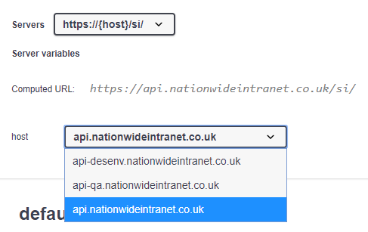
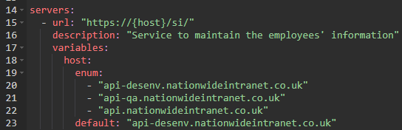
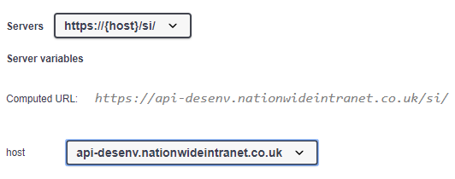
Routing Mechanism – URL Definition in Swagger
OpenApi 3.0
Notes:
Host names can be defined in the Swagger file OpenApi 3.0.
No basePath exists in OpenApi 3.0.

Slide 23

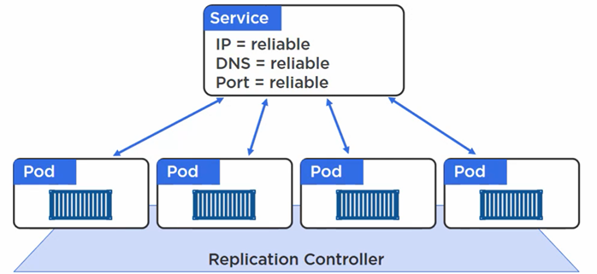
Kubernetes – Network Topology
Notes:
Service is the entry point to load balance to the pods.
The pods run under a replica controller.
If a pod dies, the load balance senses it and stop sending requests to the failing pod.
When a new pod is active, the service is notified and start sending requests to this pod.

Slide 24
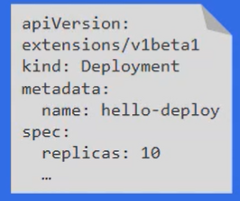
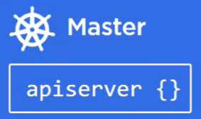


Kubernetes – Canary Deploy
Deployed
to cluster
Replica Set
(Revision 1)
Replica Set
(Revision 2)
Haroldo
Haroldo
POD
POD
POD
POD
POD
POD
Notes:
Deployment of a version using Replica Set.
# First deploy
$ kubectl create -f deploy.yaml
# To do an update, change the same yaml file.
$ kubectl apply -f deploy.yaml --record
$ kubectl rollout status deployment hello-deploy
# To undo a deploy:
$ kubectl describe deploy hello-deploy
$ kubectl rollout undo deployment hello-deploy --to-revision=1
All replica sets stay in the environment.

Slide 25
Other Considerations
Contract
Major version evolution
Source version control
Notes:
There are many other consideration when talking about versioning, this presentation wasn’t meant to cover them all.
It is part of a wider discussion and strategy decisions.

Slide 26
Other Considerations
Contract
Defines due dates or time to live of each operation version
Swagger file is an addendum
Major version evolution
All use cases that follows the spec can be implemented
Source version control system
GIT
Swagger files treated as code
Design documents – TBD
Use new tools such as Confluence
Word doc file for each operation aggregated in one service Word doc
Notes:
This PPT doesn’t detail these items.
Major version evolution PPT is being created to address all possible use cases.
A wider discussion has to be initiated to define the strategy on Contract and GIT.

Slide 27
Summary

Slide 28
Service Versioning Proposal
Only one running service in production
One URL per service
Clients only know operations major versions
Clients inform the version they know when calling a service operation
Version operation, not service
Version information in Content-Type and Accept header parameters
Swagger files treated as code
Stored in source code control repository
Does not need to follow same service version number

Slide 29
Conclusion

Slide 30
Conclusion
Services can be designed, implemented and deployed at any pace
Granular and quick deploys are possible
Interface and behaviours are maintained even after major versions deploy

Slide 31
Versioning REST
Pros:
Loose couple evolution
Clients and services operation can evolve unconditionally
Reduced time to prod
No waterfall
Allows the use of hyperlinks
Based on specification
tools implement useful features out of the box
Cons
Environment must exist in NBS
Tools should be evaluated and tested
Professional may be trained
Notes:
All cons are expected in any new solution or technology.

Slide 32
Proposals Differences
Graham | Haroldo
Version in the URL | No version in the URL Version in standard header parameters
One URI per major version (service or operation?) | Only one URI for each service (and its operations) Operation major version in standard header parameter
Minor version passed in non standard header parameter | Clients don’t know minor versions
Does not allow to remove fields or operations | Allows inclusion, changes and removal of fields and operations
Not sure on how to version the service | No service version, only operation version
How to route? | Just route
Each Swagger with its own basepath | One Swagger file can have all versions
Do not allow hyperlink | Allow hyperlinks
One running service per major version (service or operation?) | Only one running service in production
Notes:
Only agreement is to version the operations, not the services or apis.

Slide 33
Graham’s Questions
What should be versioned? Operations, Sets of Operations, APIs?
Each operation is individually versioned (not service or Swagger file)
How should version information be communicated in the interface?
Through content: field of the Swagger (produces: and consumes: in v2.0)
How should swaggers be maintained?
As a source code
How should swaggers be published?
Published together, before or after the code
How should operation calls be routed?
As there is only one URL for all service versions in prod, routing is not a problem
Notes:
Graham’s questioning from his PPT on versioning.

Slide 34
Service Versioning Proposal
Proposal on how to version Middleware Services

